Slide 1
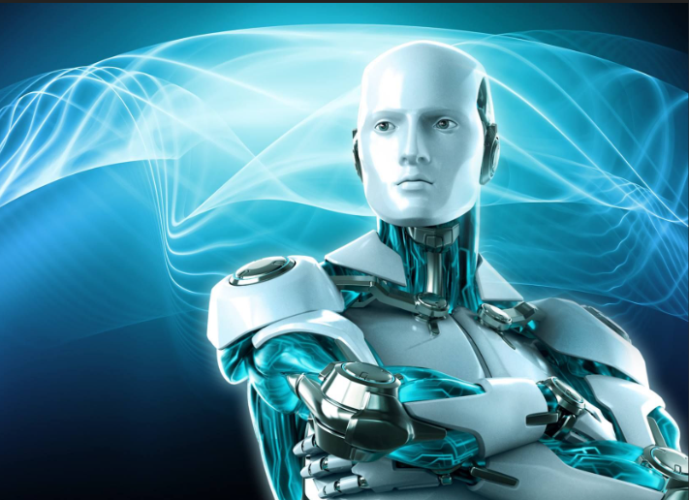
AI in Sports

Slide 2
What is AI and how it is changing the sports industry?
Artificial Intelligence (AI) is a rapidly growing field of computer science that focuses on developing machines and algorithms that can perform tasks that would typically require human intelligence to complete.
AI is quickly changing the sports industry. It is being used to optimize performance, measure data, and drive customer engagement. AI is enabling athletes to reach new levels of performance through better decision making, improved data analysis, and personalized training programs. Furthermore, AI is helping sports organizations to develop better strategies, enhance fan engagement, improve sports analytics and detect fraud in sports.

Slide 3
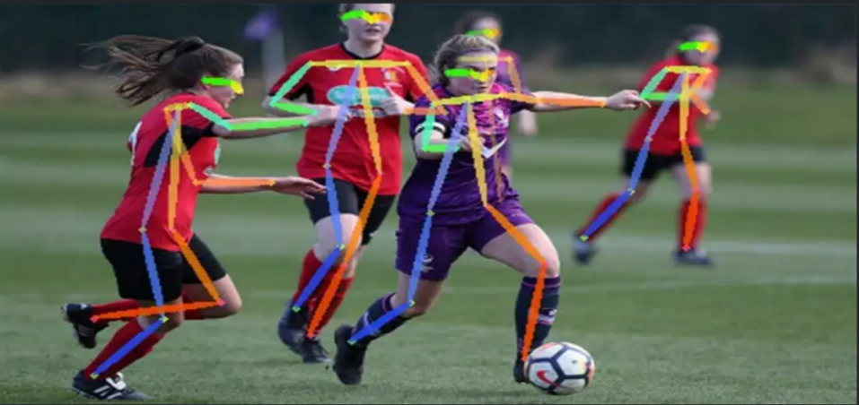
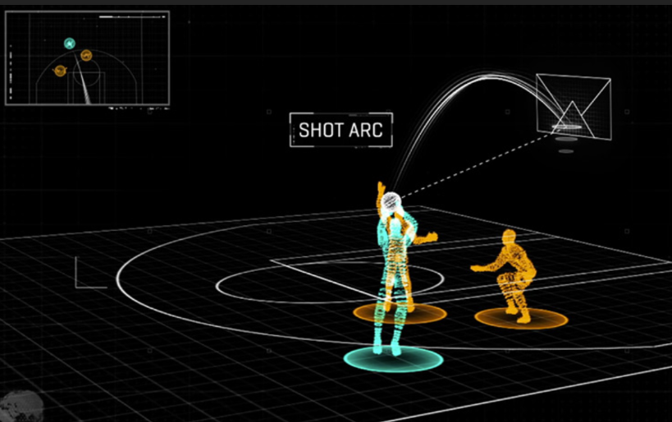
How AI is being used in different Sports
Football (Soccer): AI is used to track player movements during a game and analyze their decision-making. It can also be used to analyze data on past matches, player performance, and team strategies to help coaches make better decisions.
Basketball: AI is used to analyze player movements and shooting patterns to help coaches improve player performance. It can also be used to predict team strategies and game outcomes based on historical data.

Slide 4
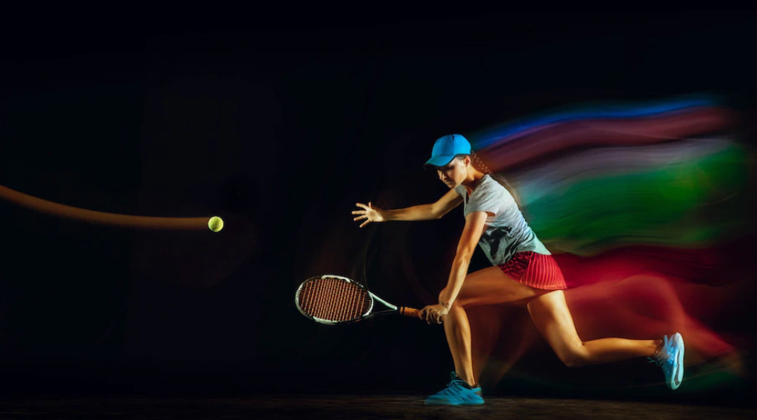
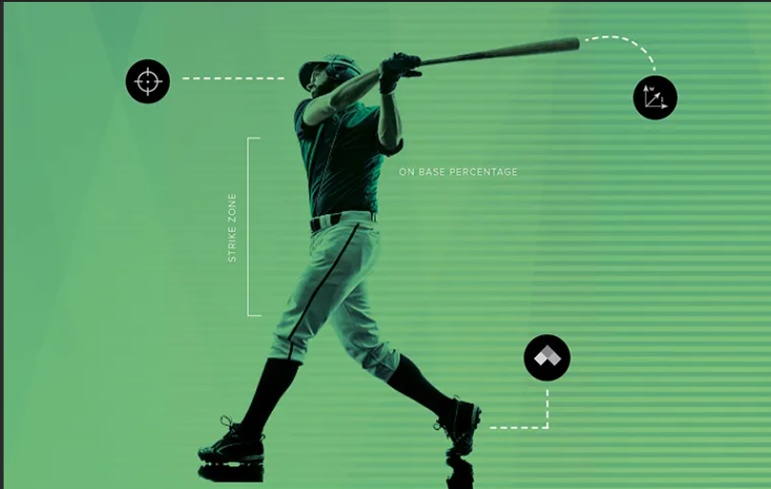
Tennis: AI is used to track player movements and analyze their shot patterns. It can also be used to predict the outcomes of matches based on historical data.
Baseball: AI is used to track player movements and analyze their performance, including pitching velocity, pitch location, and batting trends. It can also be used to predict the outcomes of games based on historical data.

Slide 5
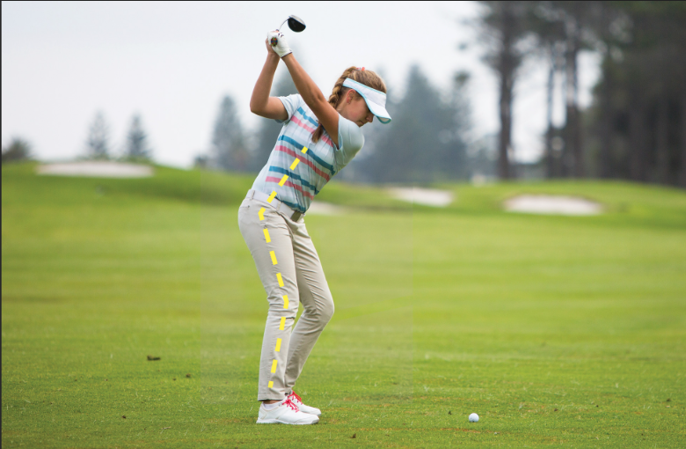
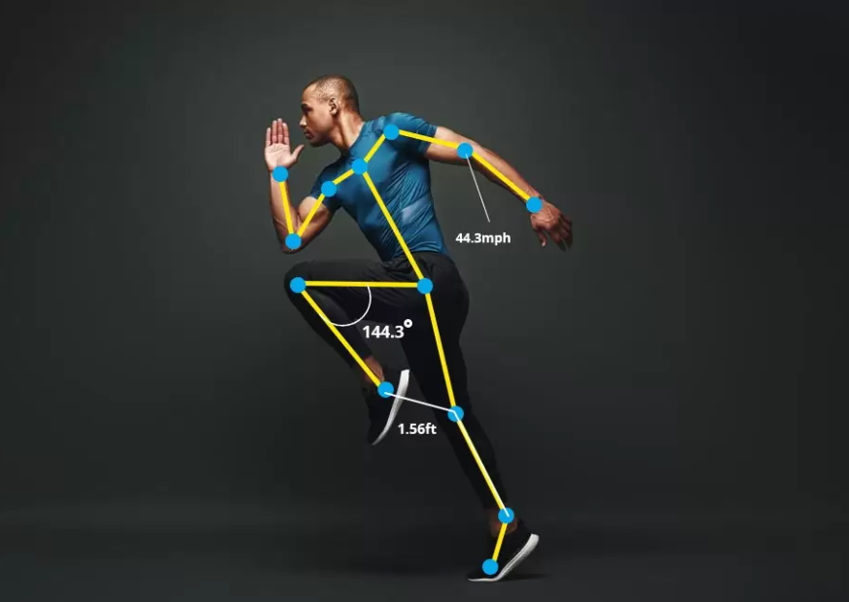
Golf: AI is used to analyze golfer's swings, providing information on swing speed, impact, and other factors that can impact performance. It can also be used to provide guidance on club selection and course management.
Running: AI is used to track runners' biometric data, such as heart rate, breathing rate, and stride length, to help them optimize their training and performance.

Slide 6
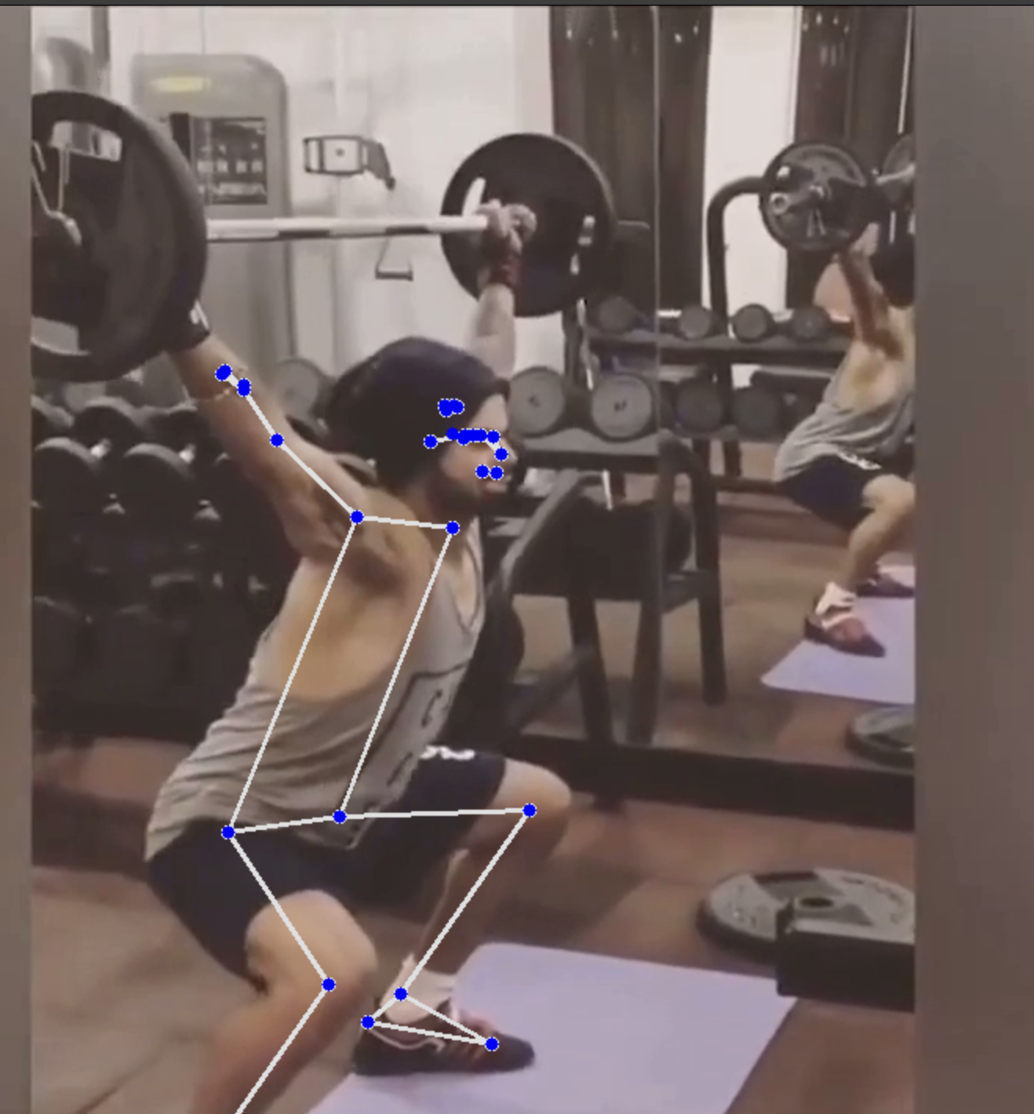
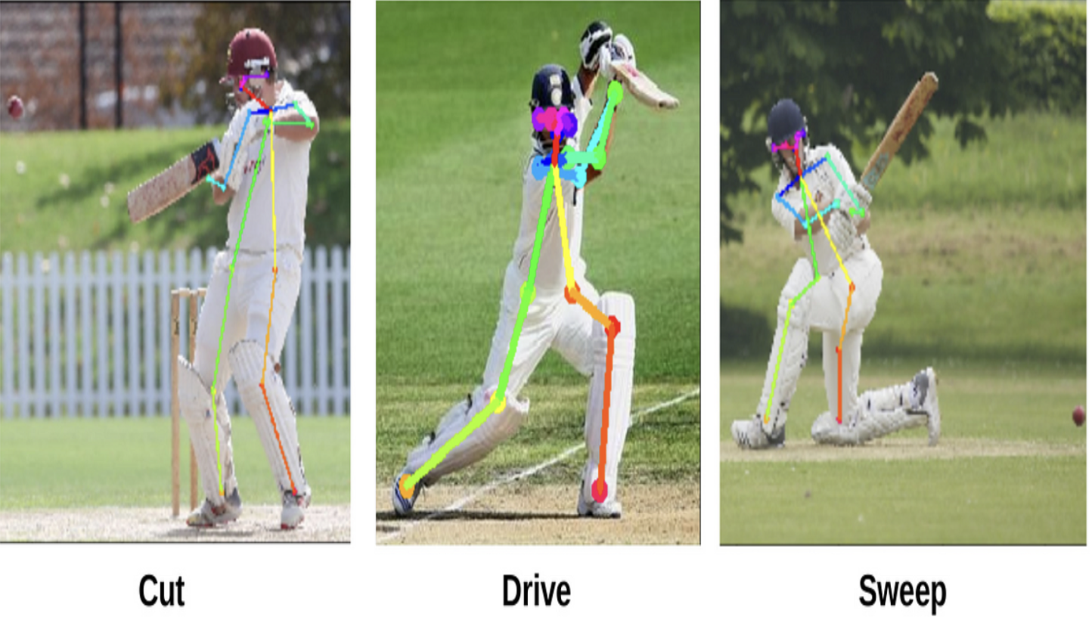
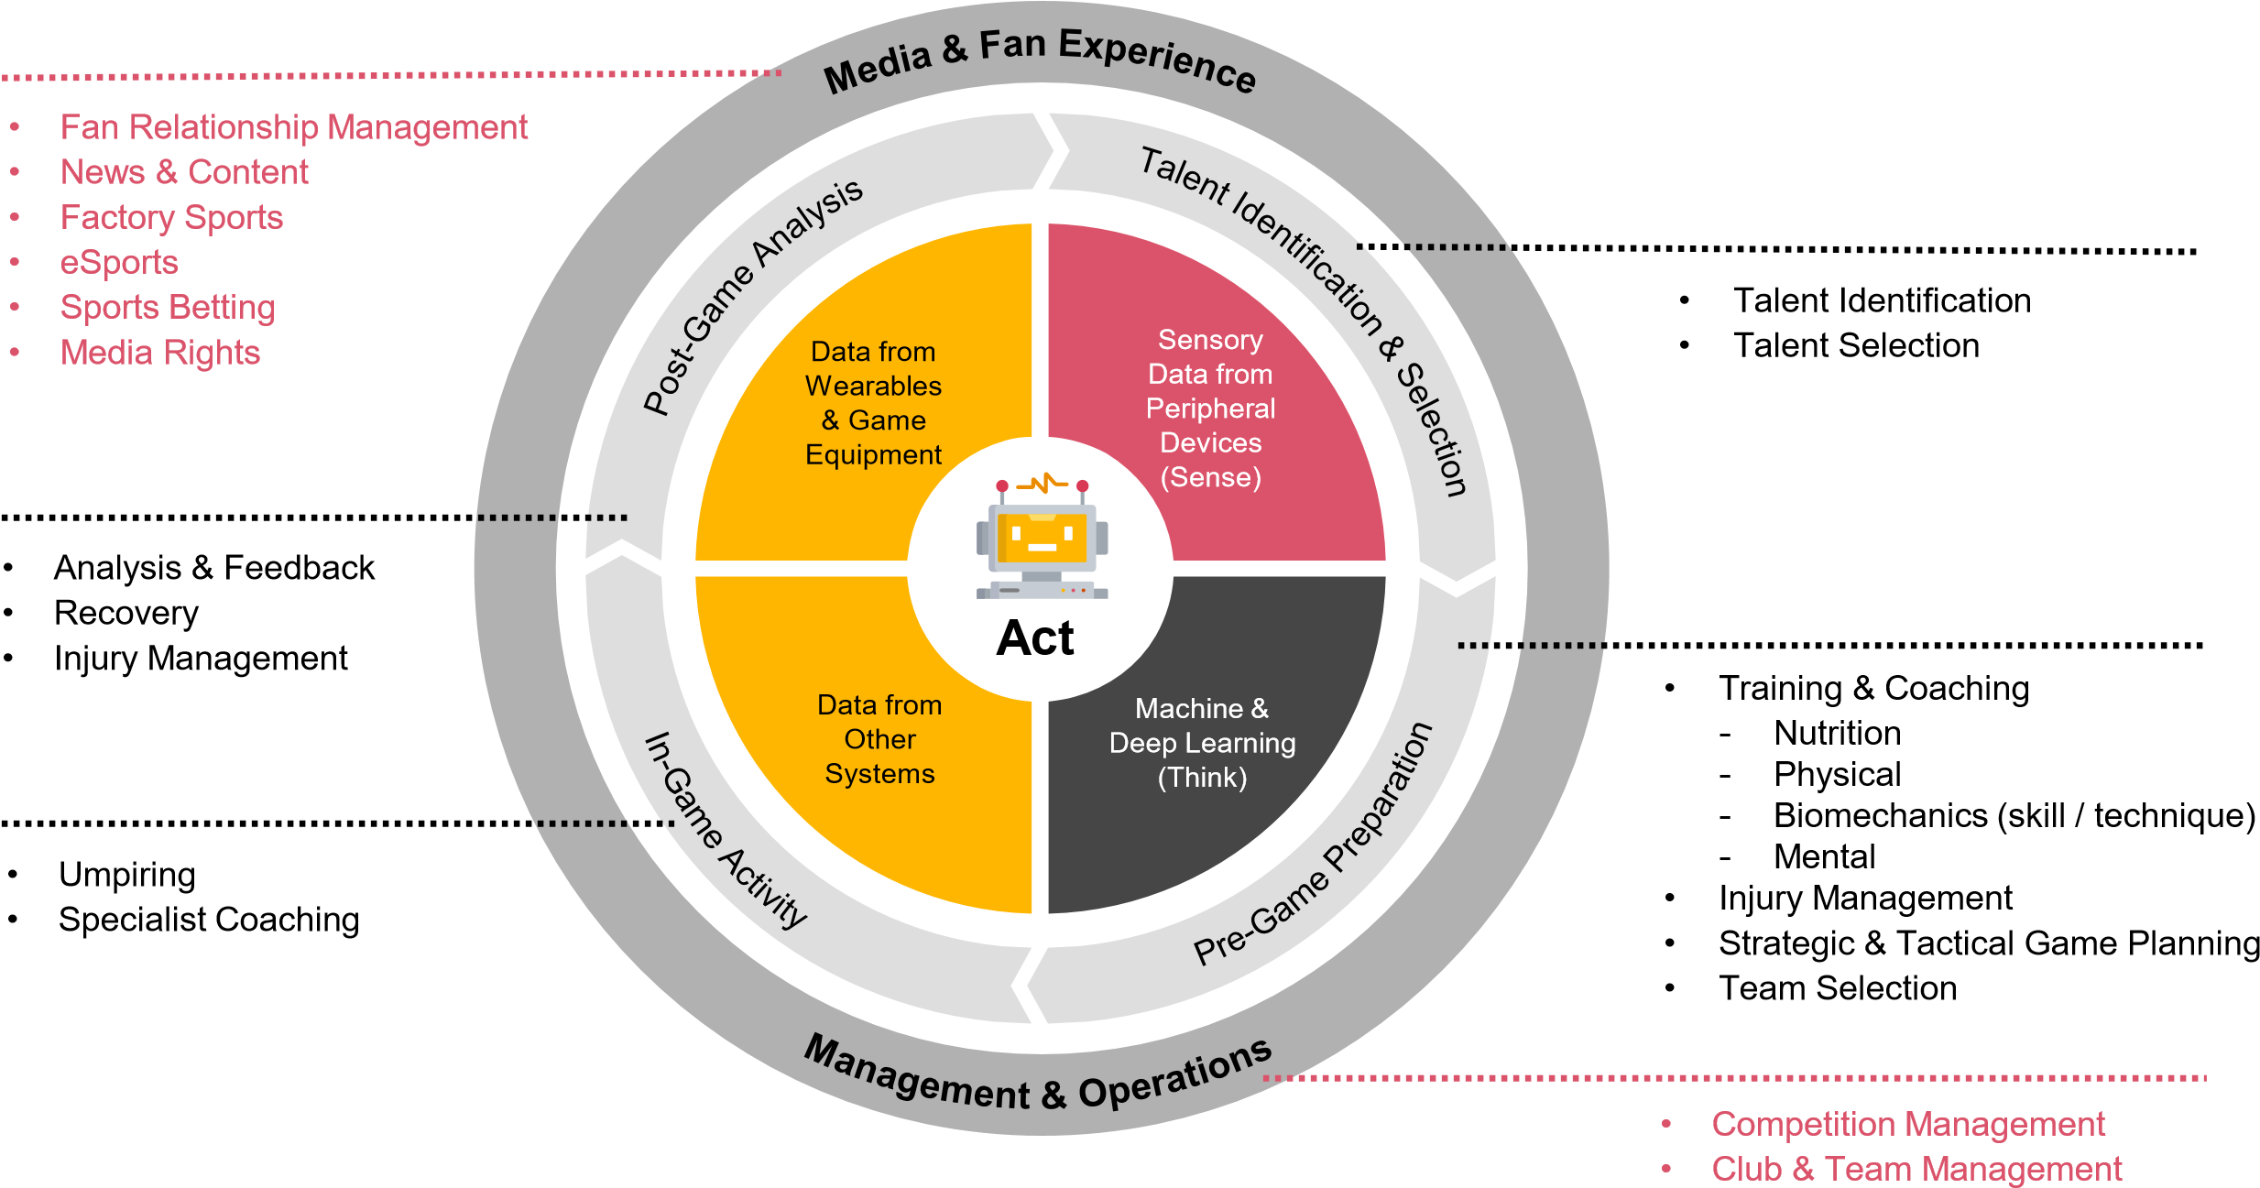
AI Technology Framework for the Sports Industry
The following diagram depicts where AI technology can be used within the sporting landscape:

Slide 7
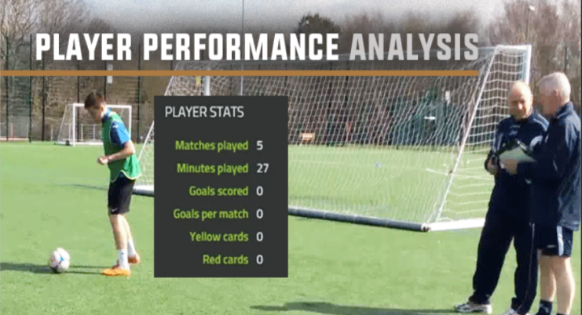
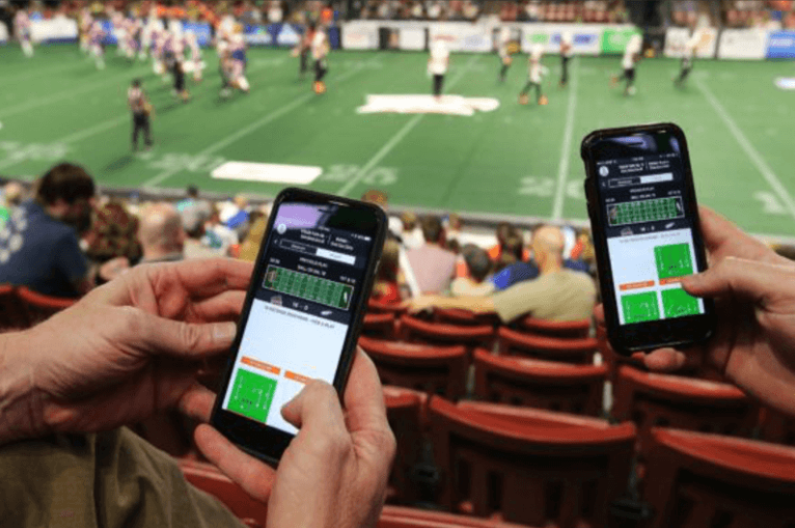
Various ways AI can be used in Sports Performance Analysis: AI can be used to analyze athlete performance by collecting data through wearable sensors and other devices. Machine learning algorithms can then be applied to this data to gain insights on an athlete’s strengths and weaknesses, which can be used to optimize their training and performance. Fan Engagement: AI can be used to enhance the fan experience by providing real time statistics and analysis during games. Fans can use this information to better understand the gane and track their favourite players.

Slide 8
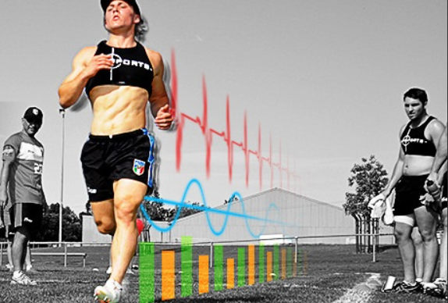

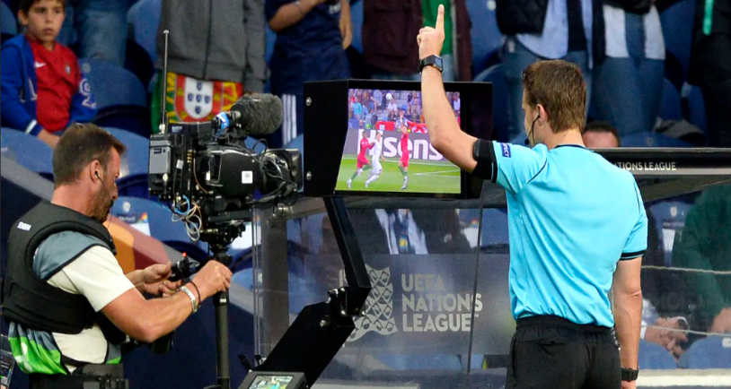
Athlete tracking:
AI can be used to track an athlete's movement, speed, and other metrics during training or competition. This can help coaches and trainers monitor an athlete's progress and adjust their training program accordingly.
Personalized Diet Plan:
, AI can also be used to create personalized diet plans. By analyzing data such as a player's age, weight, height, and activity level, AI can create a meal plan that is tailored to their nutritional needs .
Virtual Assistant Referee (VAR):
It is a technology used in sports, particularly in football (soccer), to assist the on-field referees in making important decisions.

Slide 9
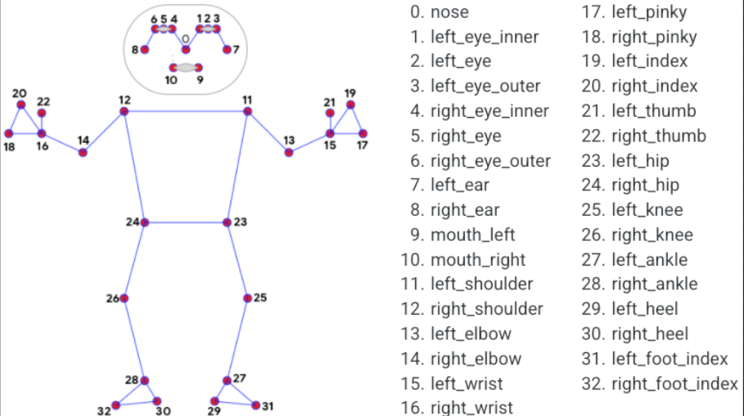
Human Pose Estimation in Sports
Human Pose Estimation is a cutting-edge technology that uses computer vision and deep learning algorithms to detect and track human body movements. It involves detecting and tracking the movements of human body joints and estimating their positions in real-time.
It includes 33 pose landmarks. All these landmarks have a specific number associaciated with them and with the help of these we can track the particular body part which provides a lot of benefits to the trainer and the athlete in order to perform a particular action in sports in correct manner.

Slide 10
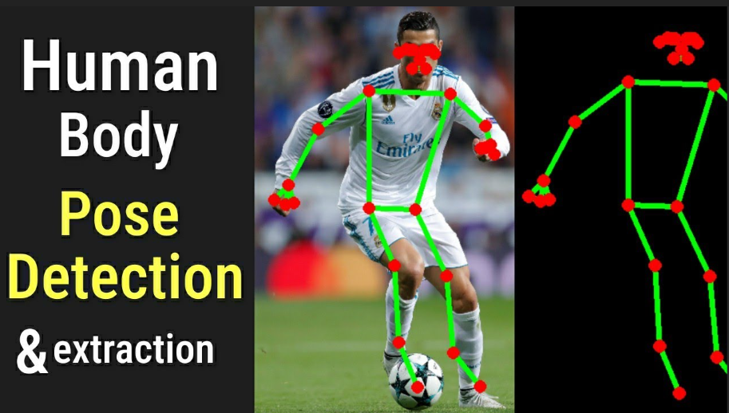
How does it work
Human Pose Estimation works by analyzing video footage and identifying key points on the human body, such as joints and limbs. These points are then used to create a 3D model of the body's movements. This allows coaches and athletes to analyze and improve performance in real-time.

Slide 11
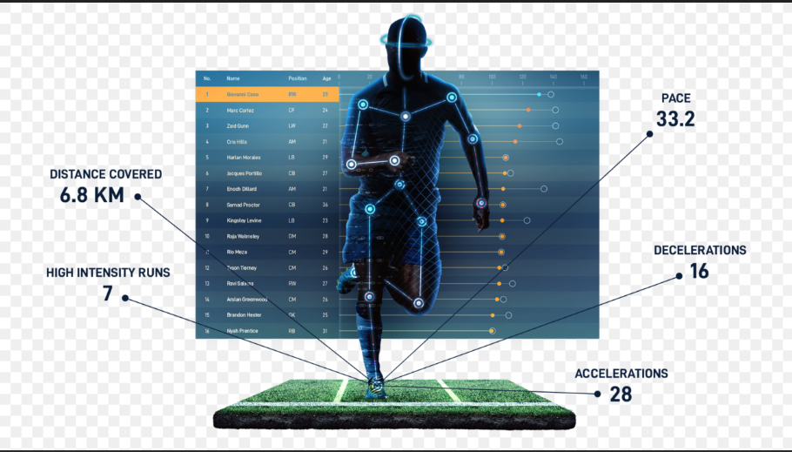
Application of Human Pose Estimation in Sports
Performance analysis: Human pose estimation can be used to track the movements of athletes during a game or training session. This information can be used to analyze their performance, identify areas for improvement, and provide feedback.
Broadcasting: Human pose estimation can also be used in sports broadcasting to enhance the viewing experience. By tracking the movements of athletes, broadcasters can create virtual replays and visualizations that provide viewers with a better understanding of the action.

Slide 12
Virtual coaching: Human pose estimation can be used to create virtual coaching systems that provide real-time feedback to athletes. By analyzing their movements and comparing them to ideal or correct form, these systems can help athletes improve their technique and avoid injury.
Injury prevention: Human pose estimation can also be used to monitor athletes for signs of fatigue or injury. By tracking changes in their posture or movement patterns, coaches and trainers can identify potential issues early and take steps to prevent injuries.

Slide 13
Challenges involved in AI in Sports
Data collection: AI models rely on high-quality data to provide accurate predictions and insights. In sports, collecting relevant data can be challenging due to the complexity of the game and the variability of the data. Data collection requires an appropriate infrastructure to collect, store, and manage the data.
Data privacy: With the increasing use of wearable technology and other sensors, there is a risk of sensitive information being compromised. Ensuring the privacy of athletes' data is crucial, and any breach could have serious consequences.

Slide 14
Bias: AI models are only as good as the data they are trained on. If the data used to train an AI model is biased, the model will also be biased. This can lead to inaccurate predictions or unfair treatment of certain athletes. For example, if the data used to train an AI model only includes male athletes, the model may not be able to accurately predict the performance of female athletes.
Implementation costs: The implementation of AI technology in sports can be expensive, making it challenging for smaller teams or organizations to adopt it. The costs associated with data collection, infrastructure, and software can be significant, and many organizations may not have the necessary resources to invest in AI technology.

Slide 15
Future of AI in Sports
The future of AI in sports is promising, with the potential to transform athlete training, performance analysis, and fan engagement. AI-powered sensors and wearables can provide real-time data on athlete performance, helping coaches and trainers make informed decisions. AI algorithms can also analyze vast amounts of video footage to identify patterns and insights that can improve strategy and tactics. AI-powered chatbots and personalized recommendations can enhance fan engagement and provide a more immersive experience. As AI technology continues to evolve, it is likely that its impact on sports will only continue to grow

Slide 16
Conclusion
AI is revolutionizing the world of sports in various ways, from improving athlete performance and injury prevention to enhancing the fan experience. AI-powered systems can analyze vast amounts of data to provide valuable insights into an athlete's performance and help coaches make more informed decisions. Additionally, AI can help sports organizations optimize operations and increase revenue through fan engagement and targeted marketing. However, the use of AI in sports also raises ethical concerns, such as privacy and fairness. Despite these challenges, it is clear that AI will continue to play an increasingly significant role in sports, transforming how we play, watch and enjoy them.

Slide 17


